Slide 1
Basic OOP in C#

Slide 2
Course objectives
After the course, student will:
Understand about OO concepts.
Understand and apply simple design pattern in the common situations.

Slide 3
Agenda
Abstraction
Encapsulation
Inheritance
Polymorphism
Abstract Class & Interface
Introduce to Design Patterns.

Slide 4
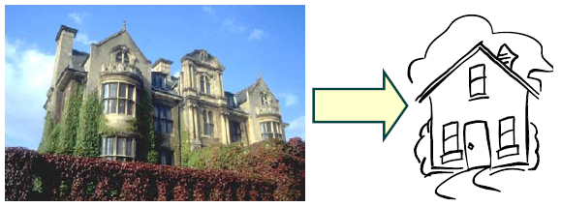
Abstraction
The art of being wise is the art of knowing what to overlook William James
Reduce complexity by focusing on the essentials relative to perspective of viewer
Notes:
Các bài toán chúng ta phải giải quyết ngày càng phức tạp. Chính vì thế chúng ta cần có kỹ thuật để giảm mức độ phức tạp mà chúng ta cần phải xem xet giải quyết tại một thời điểm.
Thời gian để chúng ta hiểu tỉ lê nghịch với số lượng thông tin mà chúng ta phải xử lý
Knowing what to overlook ➔ Reduce the amount of facts that we have to deal with simultaneously.
Example 1: bac sy xem cac thong tin ve benh nhan, tieu su. Ho tranh nhung khong tin khong can thiet, khong lien quan de tim ra nguyen nhan nhanh chong nhat
Example 2: Voi cung mot doi tuong: BOOK, thi cac thong tin can quan tam se khac nhau:
- Library System: Quan tâm tới Access Number, Book name, Author Name, year of publication …
- Book Store: Item number, Item name, Price, Quantity in stock …
Chỉ quan tâm tới những thông tin quan trọng, cần thiết để giải quyết bai toan

Slide 5

Abstraction Sample 1/2
Object: Sport Car
Data: Information
Wheel: 4 wheels
Main color: Orange
Rear port: 2 ports
With upper window: Yes
Seat: 2 seats
Cylinder volume:2.1L
Action
Engine start
Speed up, Slow down
Turn left, turn right
Stop

Slide 6

Abstraction Sample 2/2
Car is described by:
Number of wheels
Main color
Number of rear port
With upper window or not
Number of seats
Cylinder volume
Engine start
Speed up
Slow down
Turn left
Turn right
Engine Stop
Each car has its out data and actions

Slide 7



Abstraction What is an object?
Represent an entity in the “real” world
Possesses operation (behavior) and attributes (data – state)
Data ➔ contain information describe
the state of objects
Operation/Behavior ➔ Method inside class
Consists of things that the object know how to do
Unique – Identifiable
Is a “black box” which receives messages
Notes:
Every object:
- Contains data: The data stores information that describes the state of the object.
- Has a set of defined behavior. This behavior consist of all the things that the object
"knows" how to do. These are the methods present inside the object.
- Has an individual identity. Each object is different from the other object even if they
are instantiated from the same class.
A primary rule of object-oriented programming is - as the user of an object, you would never need
to know what is there inside the object!

Slide 8
Abstraction What is a class?
Abstract description of a set of objects
Class defines methods, variables for a kind of object
We actually write code for a class, not object
Use class as a blue-print to create (instantiate) an object
Polygon
Attributes:
- vertices
- border color
- fill color
Operations:
- draw
- erase
- move
instantiate
instantiate
instantiate
Notes:
Class như một bản thiết kế cho một loại object.
- Classifying objects
- Relating objects to one another
- Providing mechanism to define and manage objects.

Slide 9
Abstraction Class vs. Struct
A class or struct defines the template for an object
A class represents a reference type
A struct represent a value type
Reference and value imply memory strategies
When to use struct? | When to use class?
Instances of the type are small The struct is commonly embedded in onther type The struct logically represent a single value It is rarely “boxed” Structs can have performance benefits in computational intensive applications | Defines a reference type Can optionally be declared as: Static Abstract sealed
Notes:
Class như một bản thiết kế cho một loại object.
- Classifying objects
- Relating objects to one another
- Providing mechanism to define and manage objects.
Choosing Between Class and Struct
√ CONSIDER defining a struct instead of a class if instances of the type are small and commonly short-lived or are commonly embedded in other objects.
X AVOID defining a struct unless the type has all of the following characteristics:
- It logically represents a single value, similar to primitive types (int, double, etc.).
- It has an instance size under 16 bytes.
- It is immutable.
- It will not have to be boxed frequently.
In all other cases, you should define your types as classes.

Slide 10
Abstraction Nested/Inner class
class OuterClass{
private int i;
public class NestedClass{ // public for outside access
// not encouraged
void methodA(){
i = 5; // OK, event i is outer private
}
void methodB(){
int i = 3; // hide/shadowing the outer i
// the outer i member is unchanged
}
void methodC(){NestedClass oIC = new NestedClass();}
}
}
OuterClass oOC = new OuterClass();
OuterClass.NestedClass oIC = new OuterClass.NestedClass();
Notes:
!!Lecture nên focus vào lý do tại sao chúng ta cần nested/inner class.
Why Use Nested Classes?
There are several compelling reasons for using nested classes, among them:
It is a way of logically grouping classes that are only used in one place.
It increases encapsulation.
Nested classes can lead to more readable and maintainable code.
Logical grouping of classes—If a class is useful to only one other class, then it is logical to embed it in that class and keep the two together. Nesting such "helper classes" makes their package more streamlined.
Increased encapsulation—Consider two top-level classes, A and B, where B needs access to members of A that would otherwise be declared private. By hiding class B within class A, A's members can be declared private and B can access them. In addition, B itself can be hidden from the outside world.
More readable, maintainable code—Nesting small classes within top-level classes places the code closer to where it is used.

Slide 11
Abstraction Partial class
partial class PartialClass{private int i;}
class PartialClass{} // error, keyword partial missed
class partial PartialClass{} // error, invalid keyword order
partial class PartialClass{ // maybe in another cs file but
// same namespace is required
pubblic int Increase(){i++;}
}
…
partial class PartialClass{
partial class NestedPartialClass{}
}
partial class PartialClass{
partial class NestedPartialClass{} // OK, nested partial class
}
Notes:
Separate code for maintenance
Allow a class to be split between several source files.
Một công cụ cho phép chúng ta tổ chức lại code bên trong 1 class trong một vài tình huống đặc biệt:
Một class bao gồm những source code khó đọc, xấu xí do generate ( bằng tool) và phần source code còn lại cần thiết phải code bằng tay.
Một class mà implement nhiều interface.

Slide 12
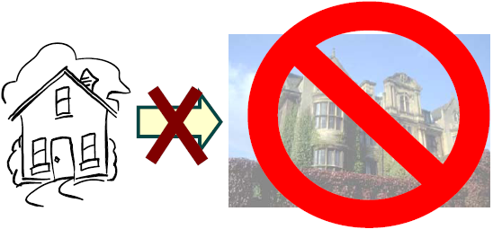
Encapsulation
Allow to show only the important methods as interface
Hide detail information
Hide the data item
Hide the implementation
Access to data item only through member methods
Notes:
Capsule vs Tablet
Tablet : Thông tin/thành phần được exposed ra bên ngoài. Thuoc de bi tuong tac voi khong khi va nuoc. Khi uong co the co cam nhan ve mui vi cua thuoc
Capsule: Thành phần được gói kín bên trong. Thanh phan cua thuoc duoc bao ve tot hon. Khi uong, it kha nang cam nhan ve mui vi cua thuoc.
Encapsulation : Separate External Aspect from internal Implementation
Với encapsulation, OO can:
- hide the data item
- Chi co the access data item thông qua member method
Abstraction: Tell the external face we should present to the world
Encapsulation: Ensure implementation is not leak out
Abstraction & Encapsulation together reduce the amount of information we have to deal with.

Slide 13
Encapsulation Class, Member and Method
class Car{ //Object model
int NumberWheels; //Data => Member
string MainColor;
int NumberRearPorts;
bool isWithUpperWindow;
int NumberSeats;
float CylinderVolume;
void EngineStart(){…} //Action => Method
void SpeedUp(){…}
void SlowDown(){…}
void TurnLeft(){…}
void TurnRight(){…}
void Stop(){…}
}
Object Oriented Programming
Notes:
Combine the action with data in an IT Object => OOP

Slide 14
Encapsulation Instantiate, Constructor
// Instantiate – Create an object/"instance"
// from its model class with "default constructor"
Car aCar = new Car();
aCar = null; // now, aCar is no more an object
class Car{
// Parameterized constructor
Car(int NumberWheels, string MainColor,
int NumberRearPorts, bool isWithUpperWindow,
int NumberSeats, float CylinderVolume){
this.NumberWheels = NumberWheels;
this.MainColor = MainColor;
this.NumberRearPorts = NumberRearPorts;
this.isWithUpperWindow = isWithUpperWindow;
this.NumberSeats = NumberSeats;
this.CylinderVolume = CylinderVolume;
}
…
}
// New instantiation with parameterized constructor
Car aCar = new Car(2, "Orange", 2. true, 2, 2.1);
// all members of aCar are now called instance variables
// then, all methods are instance methods
Notes:
Constructor called at object creation
Constructor by default
Not OK yet, need public access modifier next page
this keyword access the current object

Slide 15
Encapsulation Access Modifiers
Used for accessibility of data member and member methods
Access Modifiers: Private, Public, Protected
class Car{
private int NumberWheels; // private
string MainColor; // no access modifier means private
…
public Car(…){…} // public constructor
public void EngineStart(){…}
public void SpeedUp(){…}
public void SlowDown(){…}
public void TurnLeft(){…}
public void TurnRight(){…}
public void Stop(){…}
}
Car aCar = new Car(…);
aCar.EngineStart(); // OK, method is public
aCar.NumberWheels = 6; // error: member is private
Notes:
Private: data hoặc method được giấu, các object bên ngoài không thể access
Public: data hoặc method được public và có thể được accessed/modified bởi các object bên ngoài
Protected: data hoặc method có thể access/modified bởi các class thuộc cùng module/package
Friendly: data hoặc method có thể access/modified bởi các class được khai báo là friend của class đó.
public : Access is not restricted.
protected : Access is limited to the containing class or types derived from the containing class.
Internal : Access is limited to the current assembly.
protected internal: Access is limited to the current assembly or types derived from the containing class.
private : Access is limited to the containing type.
-----

Slide 16
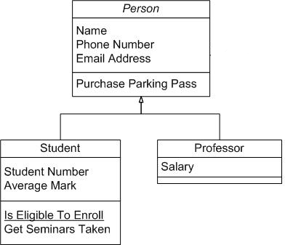
Inheritance
Is the ability to compose new abstraction from existing one
Promotes Re-usability
Base class – Super class: Class provide implementation
Derived class – Subclass: The class inheriting the implementation
Notes:
Promote re-use: Không phải bắt đầu từ đầu khi xây dựng một class mới. Có thể inherite các member data, method từ một class tương tự, và chỉ cần bổ xung các new feature
Base class – Super class – Parent class
Derived class – Sub class – Child class

Slide 17
Inheritance Inheritance – Extension
Vehicle
EngineStart()
SpeedChange()
Turn()
Stop()
Car
class Car: Vehicle {…}
// Car is a kind of Vehicle
// Car: derived/sub class
// Vehicle: base/super class
Vehicle v = new Car(); // OK
Vehicle v = new Plan(); // OK too
Vehicle v = new CombatPlan(); // OK
Plan p = new CombatPlan(); // OK
Car c = new Vehicle(); // error
Car c = new Plan(); // error
Plan
HighUp()
Down()
CombatPlan
Rotate()
Notes:
Object class is the base class of all class

Slide 18
Inheritance Advantages
Development model closer to real life object model with hierarchical relationships
Reusability – reuse public methods of base class
Extensibility – Extend the base class
Data hiding – base class keeps some data private
➔ derive class cannot change it
Protected Accessibility:
class Car{
protected int NumberWheels;
protected string MainColor;
protected int NumberRearPorts;
protected bool isWithUpperWindow;
protected int NumberSeats;
protected float CylinderVolume;
…
}
Notes:
All benefit apply to design, development and maintenance

Slide 19
Inheritance this, base, sealed class
class A{
protected int i;
protected int aMethod(int i){
this.i = i; // refer to current object
return i;
}
}
class B:A{
public int aMethod(int i){
return base.aMethod(i); // refer to parent
}
}
sealed class A{} // Inheritance forbidden
class B:A{} // error
static class C{}
class D:C{} // error: static implies sealed
Notes:
Abstract class : class do not represent anything concrete (cụ thể).
Class as “holder” for the shared/inherited attributes and behavior for derived classes.
[anhndd] ->DO NOT define public or protected internal constructors in abstract types.

Slide 20
Polymorphism
Polymorphism = multiple forms/many shape
By Definition:
1. The ability of objects to have different operations from the same interface.
2. The ability of different objects to respond in their own unique way to the same message
Implemented by:
Overloading
function overloading
operator overloading
Override
Notes:
Bổ xung hình vẽ

Slide 21
Polymorphism Override - Feature Hiding
class A{
public int DefaultTempeture(){
return 25;
}
}
class B:A{
// object of type A cannot use the
// following method,
// the "new" keyword is optional
public new int DefaultTempeture(){
return 28;
}
}
A a = new B();
int x = a.DefaultTempeture(); // x = 25

Slide 22
Polymorphism Override - Feature Override
class A{
// virtual prevent for override : sai
public virtual int DefaultTempeture(){
return 25;
}
}
class B:A{
// override: for predefined virtual only
// override: used for "deferred loading"
public override int DefaultTempeture(){
return 28;
}
}
A a = new B();
int x = a.DefaultTempeture(); // x = 28

Slide 23
Polymorphism Binding
Process of connecting a method to a method body
Static binding:
Binding is performed before program runs – At Compile time
…
animal* p;
…
p->run(40);
class animal
…
float run(int distance)
{
…
}
…
animal* p;
…
p->init();
At compile time
At run time
class tiger
…
void init ()
{
…
}
class dog
…
void init ()
{
…
}
Dynamic binding:
Binding is performed at the time of execution – Run time
Notes:
Thay ví dụ C++ bằng C#.

Slide 24
Polymorphism Static Binding
Also called early binding
…
animal* p;
…
p->run(40);
class animal
…
float run(int distance)
{
…
}
At compile time
Function overloading implement static binding
Compiler decides the overloaded function to be invoked by looking at signature
Binding get earlier:
Efficiency goes up – Run-time efficiency – compiler optimize code
Safety goes up
Flexibility goes down
Notes:
Bổ xung hình vẽ thể hiện static binding, cách compiler quyết định invoke overloaded function
Bổ xung pro- con cho cả static binding và dynamic binding
Xóa file này vì không fu hợp Csharp.

Slide 25
Polymorphism Dynamic Binding
Which method called depends upon the type of object
The type of object cannot be resolved at the time of compilation.
Dynamic binding resolves the method to be used at run-time
…
animal* p;
…
p->init();
Method overriding :
Use dynamic binding
Flexible – high level of problem abstraction
At run time
class tiger
…
void init ()
{
…
}
class dog
…
void init ()
{
…
}
Notes:
Pro:
Good evolution: can easily add new derived class with new method implementation
Easily iterate over similar types of object
Cons:
Performance: Run-time lookup base on type
Have to design base class carefully – Don’t want to break the derive class
Harder to understand code. Have to study several classes to understand.

Slide 26
Abstract Class & Interface Abstract Class 1/2
Class that contains one or more abstract methods
Abstract method: Method that has only declaration but no implementation.
Classes that extend abstract class make them concrete by implementing those abstract methods
Notes:
Abstract class : class do not represent anything concrete (cụ thể).
Class as “holder” for the shared/inherited attributes and behavior for derived classes.

Slide 27
Abstract Class & Interface Abstract Class 2/2
abstract class A{ // having at least one abstract method
// abstract method: no implementation
public abstract int DefaultTempeture();
// ordinal method: with implementation
public int TempIncStep(){
return 1;
}
}
class B:A{}
class C:B{}
public override int DefaultTempeture(){
return 25;
}
}
A a = new A(); // error: no infor about DefaultTempeture behavior
B a = new B(); // error: no infor about DefaultTempeture behavior
C a = new C(); // OK
A a = new C(); // OK
B a = new C(); // OK
Notes:
Abstract class has abstract method (and normal method too)
Abstract method has not implementation
Derived class has to implement ALL abstract inherited methods

Slide 28
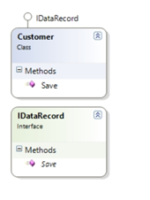
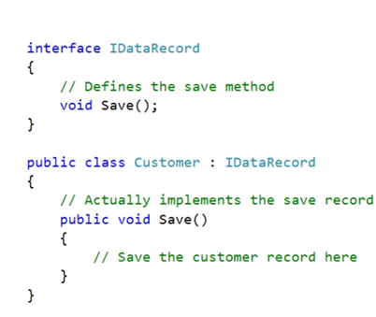
Abstract Class & Interface Interface 1/3
An interface defines a set of related functionality that can belong to one or more classes or structs.

Slide 29
Abstract Class & Interface Interface 2/3
An interface defines a contract
An interface is a type
Includes methods, properties, indexers, events
Any class or struct implementing an interface must support all parts of the contract
Interfaces provide no implementation
When a class or struct implements an interface it must provide the implementation
Interfaces provide polymorphism
Many classes and structs may implement a particular interface
Notes:
In scenarios where completely different objects need to support some kind of shared functionality like, let’s say, persist to XML, classes can implement interfaces that make them compatible with even if they don’t share the same base class. This provides most of the benefits of multiple class inheritance without the nasty side-effects that this usually brings.
Interface members are implicitly public and abstract.

Slide 30
Abstract Class & Interface Interface 3/3
interface IA{ // Interface is a special "abstract" class
int i; // Error: no member is allowed
int NewTempeture{get;} // OK
int DefaultTempeture(); // no abstract keyword, no access modifier,
// public access is fixed
int TempIncStep(){ // Error: No ordinal method allowed
return 1;
}
}
abstract class A:IA{} // abstract class can prevent the
// implementation of an interface
class B:IA{ // non-abstract class, when declared to use
// an interface, must implement all methods
// declared in the interface
public int DefaultTempeture(){return 1;}
}
class C:A{
public int DefaultTempeture(){return 2;}
}
IA a = new B(); IA b = new C(); // Interface is a type
Notes:
No normal method in interface
Declare variable of interface type
All feature are public

Slide 31
Abstract Class & Interface Multi Inheritance
Classes and structs can inherit from multiple interfaces
Interfaces can inherit from multiple interfaces
class A1{void a1(){}}
class A2{void a2(){}}
class A:A1, A2{}
// Error: "class multi inheritance" forbidden
interface IA1{void IA();}
interface IA2{void IA();}
class A:IA1, IA2{
// OK interface "multi interface" implementation
void IA1.IA(){} // All explicit implementation
void IA2.IA(){}
}
class B:IA1, IA2{
void IA(){} // one implementation for all interface
}
Notes:
Explicitly specify the Interface name when doubt in case of multi implementation

Slide 32
Abstract Class & Interface Abstract Class vs. Interface
Abstract: - Single inheritance - Fast performance - Security problem in distributed application - When base class change lead to the changing derived class.
Interface: - Multiple inheritance. - Slow performance but flexible - Good for separate interface & implementation ( eg : plug-in programming)
More : http://liveonmyown.wordpress.com/2007/09/11/abstract-class-vs-interface/

Slide 33
Lesson Summary
Object-oriented systems describe entities as objects.
Objects are part of a general concept called classes
Abstraction
Encapsulation
Inheritance
Polymorphism
Object Oriented
Abstract class, Concrete class, Base class, Derive class, Attribute, Method,
Instance, Instantiation,

Slide 34
Introduce to Design Pattern

Slide 35
Design Patterns
What are Design Patterns?
Why Design Patterns?
Case Study:
Observer design pattern

Slide 36
What are Design Patterns ?
Design patterns are:
Schematic descriptions of design solutions to recurring problems in software design, and
Reusable (i.e., generic), but don’t have to be implemented in the same way.
That is, describe:
Design problems that occur repeatedly, and
Core solutions to those problems.

Slide 37
Why Design Patterns ?
To capture and document software design knowledge.
=> helps designers acquire design expertise.
To support reuse in design and boost confidence in software systems.
To provide a common vocabulary for software designers to communicate their designs.

Slide 38
Case Study
A very common requirement in any complex system is the ability for an object to know whenever an event happens or whenever another object changes its state (which can also be viewed as an event).
Examples:
Interest rates lowered
File I/O request is complete
Mouse button was depressed.

Slide 39
Polling vs. Notification
There are two primary approaches:
Polling – Any object that is interested in state changes will periodical inquire the state.
=> Difficult to get to work with events.
Notification – Objects register to receive an update or notification whenever state changes or an event occurs. A publisher ensures that everyone is notified.
=> Observer Design Pattern

Slide 40
Observer Pattern
Also goes by the name Publisher-Subscriber.
When one object changes state, all the dependent objects are notified and updated.
Allows for consistency between related objects without tightly coupling classes
e.g. “reduces coupling between objects”

Slide 41
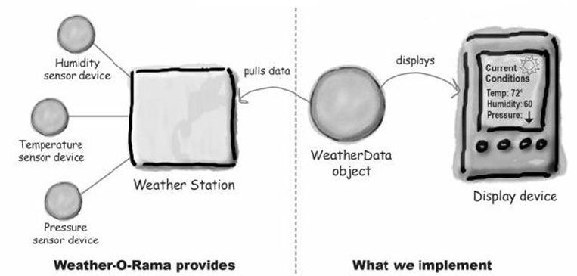
A Problem
Multiple displays need to be updated with weather data from a single weather station

Slide 42
A naive solution
public class WeatherData {
// instance variable declarations
public void MeasurementsChanged() {
float temperature = getTemperature();
float humidity = getHumidity();
float pressure = getPressure();
currentConditionsDisplay.update( temperature, humidity, pressure);
statisticsDisplay.Update( temperature, humidity, pressure);
forecastDisplay.Update( temperature, humidity, pressure);
}
// other weather data methods here
}

Slide 43
Problems with this Solution
Identify the aspects of your application that vary and separate them from what stays the same.
Program to an interface, not an implementation.
Strive for loosely coupled designs between objects that interact.

Slide 44
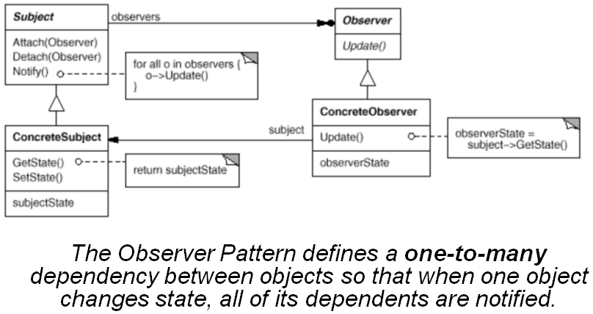
The Observer Pattern

Slide 45
Key Players
Subject Interface
Knows its observers – provides interface for attaching/detaching subjects
Observer Interface
Defines an interface for notifying the subjects of changes to the object (ex. Data)
ConcreteSubject
Sends notification to observers when state changes
ConcreteObserver
Implements Observer interface

Slide 46
Code Example
public interface IPublisher
{ public void AddSubscriber( ISubscriber subscriber ); public void RemoveSubscriber( ISubscriber subscriber );
}
public interface ISubscriber
{ public void Update( object sender );
}

Slide 47
Consequences
This is perhaps too abstract. Usually have a more semantic-based interface.
Abstract coupling between subject and observer
Coupling is abstract, thus minimal (concrete class isn’t known)
Can have multiple layers of abstraction
Support for broadcast communication
Subject doesn’t need to know its receivers or even how many subscribers it has.

Slide 48
Implementing to Interfaces
public interface IWeatherPublisher
{ void AddSubscriber( IWeatherObserver subscriber ); void RemoveSubscriber( IWeatherObserver subscriber );
}
public interface IWeatherObserver
{ void Update( float temp, float humidity, float pressure );
}
public interface DisplayElement {
void Display();
}

Slide 49
Implementing IWeatherPublisher
public class WeatherData : IWeatherPublisher
{
private IList<IWeatherObserver> observers = new List<IWeatherObserver>();
private float temperature;
private float humidity;
private float pressure;
public void AddSubscriber( IWeatherObserver subscriber ) {
observers.Add( subscriber );
}
public void RemoveSubscriber( IWeatherObserver subscriber ) {
if( !observers.Contains(subscriber) )
throw new ArguementException(“Subscriber does not exist”);
observers.Remove(subscriber);
}

Slide 50
Implementing IWeatherPublisher
public void SetMeasurements( float temperature, float humidity,
float pressure) {
this.temperature = temperature;
this.humidity = humidity;
this.pressure = pressure;
notifyObservers();
}
private void NotifyObservers() {
foreach (IWeatherObserver observer in observers)
{
observer.Update( temperature, humidity, pressure );
}
}
// other WeatherData methods here - getters
}

Slide 51
Implementing Observers
public class CurrentConditionsDisplay : IWeatherObserver , DisplayElement {
private float temperature;
private float humidity;
public CurrentConditionsDisplay( IWeatherPublisher weatherData ) {
weatherData.AddSubscriber( this );
}
public void Update( float temperature, float humidity, float pressure ) {
this.temperature = temperature;
this.humidity = humidity;
Display();
}
public void Display() {
System.Console.Writeline( "Current conditions: " + temperature
+ "F degrees and " + humidity + "% humidity");
}
}

Slide 52
Push vs Pull
This solution pushes data to the observers
public void Update( float temperature, float humidity, float pressure) {
this.temperature = temperature;
this.humidity = humidity;
Display();
}
The observers may not use all of the data or may need different data?
Observers can pull the specific data they need from the subject
public void Update( IWeatherPublisher weatherData ) {
this.temperature = weatherData.Temperature;
this.humidity = weatherData.Humidity;
Display();
}

Slide 53
Loose Coupling
When two objects are loosely coupled, they can interact, but have very little knowledge of each other.
The Observer Pattern provides an object design where subjects and observers are loosely coupled.
The only thing the subject knows about an observer is that it implements a certain interface
We can add new observers at any time.
We never need to modify the subject to add new types of observers.
We can reuse subjects or observers independently of each other.
Changes to either the subject or an observer will not affect the other.

Slide 54

Question & Answer

